Slide 1
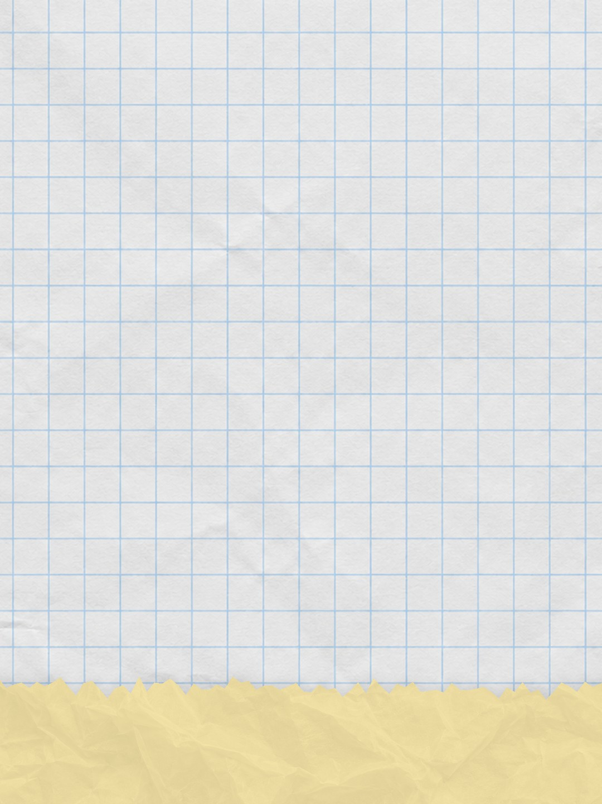


I tried to
[ruin] it
Everything blue is a guide. Delete it before you download.
Notes:
Slide 1. Hook. Swap in a photo of your product mid-test. Edit [ruin].

Slide 2
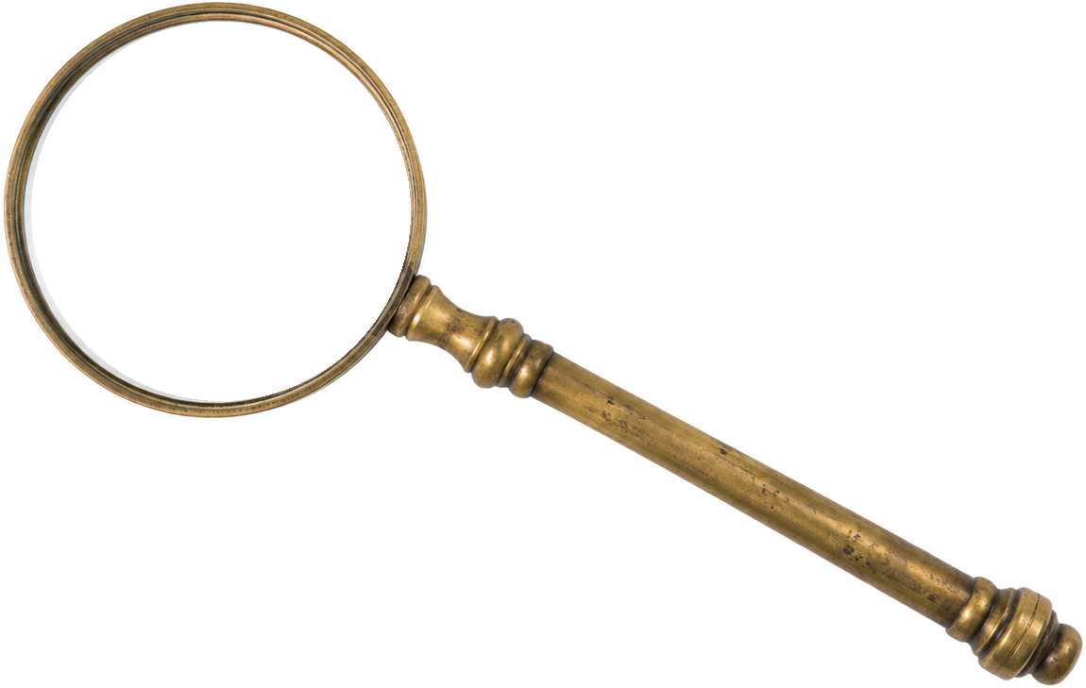

[does it really
STAY DRY?]
[watch this]
Notes:
Slide 2. Second hook: Instagram often shows a carousel starting on slide 2, so this one works as a cover on its own. Swap in a photo of the setup (it shows inside the lens). Edit both [bracket] lines.

Slide 3

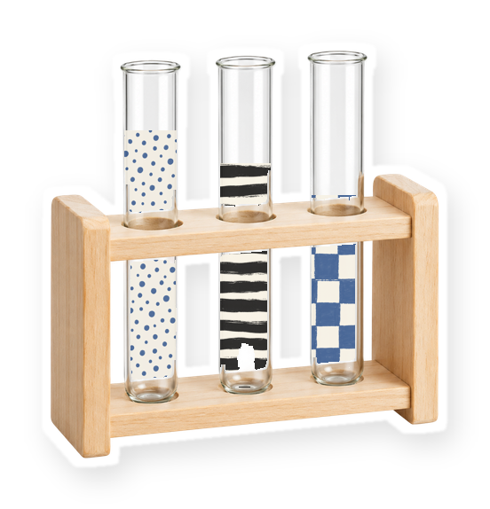
let's test it
claim:
[stays dry]
Notes:
Slide 3. The claim you are testing. Edit the note.

Slide 4


[one take, no cuts]
watch closely
Notes:
Slide 4. Swap in a still from your one-take test. Edit the line.

Slide 5



did it...?
Notes:
Slide 5. Swap in a photo of the result (it shows inside the lens).

Slide 6
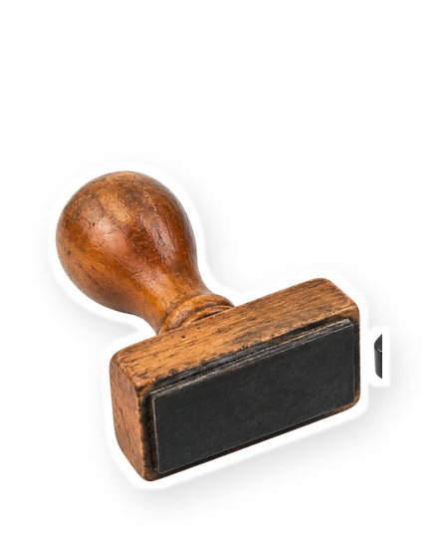

[IT STAYED DRY]
Notes:
Slide 6. Swap in a photo of the result. Edit the line.

Slide 7




Comment
"[KEYWORD]"
Notes:
Slide 7. Swap in a photo of your product. Type your keyword. Caption to start from (CTA in the first two sentences, 3 hashtags): Comment [KEYWORD] and I will send you [the link]. [One line of real context: who it helps or how you use it.] #[tag] #[tag] #[tag]

